Slide 1
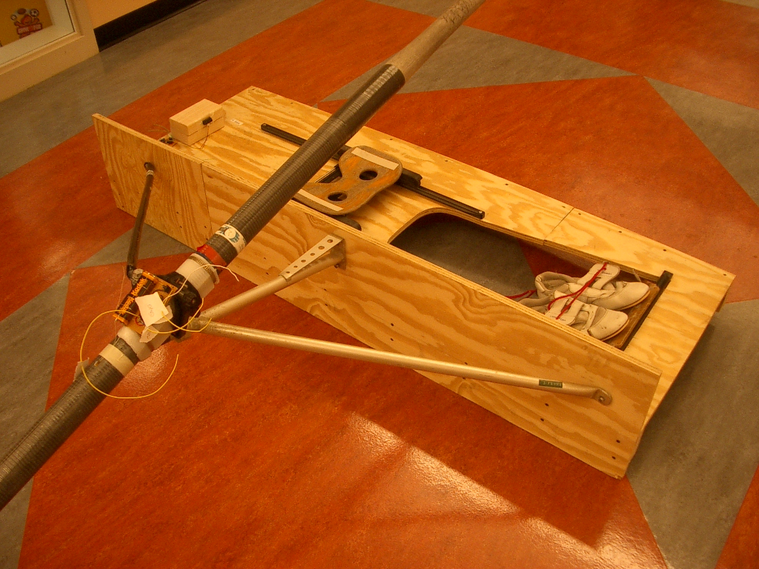
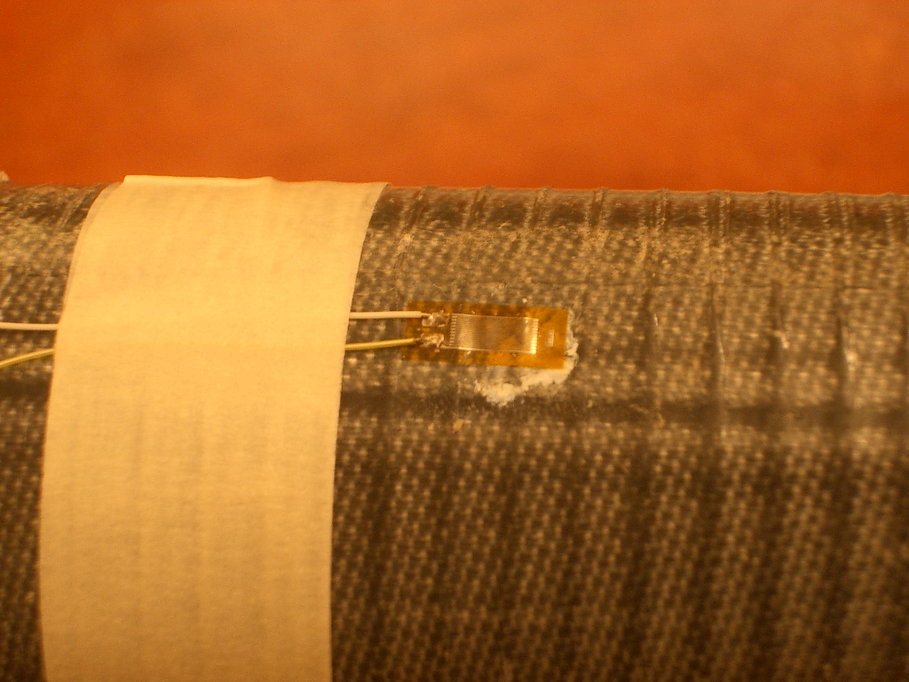
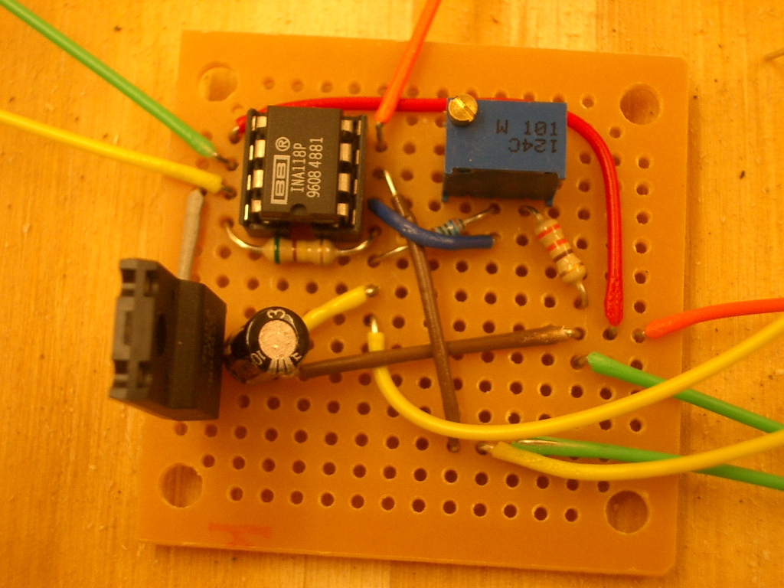
Trial 1 – Successful – Pressure Sensor
Strain Gauges
Wheatstone Bridge Circuit
ENCL-4.2

